Slide 1
Habitat destruction
IGCSE Biology
Wendy Chai

Slide 2

Why habitat destruction
Clear land for farming (cropland or pasture for livestock), construction like building houses and roads.
Remove wood to build furniture or as fuel, etc.
Mining for natural resources (e.g. metal ores and fossil fuels
Release pollutants to land and water
Remove key species (organism that has a major influence on the way its ecosystem works) e.g. https://www.nationalgeographic.org/article/role-keystone-species-ecosystem/?utm_source=BibblioRCM_Row
Vocabulary: vegetation, opencast mining, coral, coral reef, reforest
Notes:
Without its keystone species, the ecosystem would be dramatically different or cease to exist altogether.
Keystone species have low functional redundancy. This means that if the species were to disappear from the ecosystem, no other species would be able to fill its ecological niche.
Any organism, from plants to fungi, may be a keystone species; they are not always the largest or most abundant species in an ecosystem.
In many cases, a keystone species is a predator. The reason for this is that a small population of predators is able to influence the distribution and numbers of many prey species. Predators not only affect prey populations by reducing their numbers, but they also alter the behavior of prey species--where they forage, when they are active, and how they select habitats such as burrows and breeding grounds.
When a keystone species is removed from an ecological community, there is a chain reaction throughout many parts of the community. Some species become more numerous while others suffer population declines. The plant structure of the community may be altered due to increased or decreased browsing and grazing by certain species.

Slide 3
Video clips
1. We need IMMEDIATE action to stop extinction crisis, David Attenborough - BBC.mp4
Extinction crisis, general human impact, actions we can take
2. 9 Habitats That Were Ruthlessly Destroyed.mp4
Habitat degradation, Mediterranean basin, habitat fragmentation, Tropical Andes, impact on humans, Borneo
3. Habitat Loss Documentary.mp4
From habitat loss to biodiversity
4. The destruction of the Amazon, explained.mp4
Saving Amazon

Slide 4
Coral reef
Coral reefs are one of the most vibrant and biologically diverse ecosystems on the planet. Microscopic plankton, as well as crustaceans, mollusks, sponges, fish, and marine reptiles and mammals, are all part of healthy coral reef ecosystems.

Slide 5
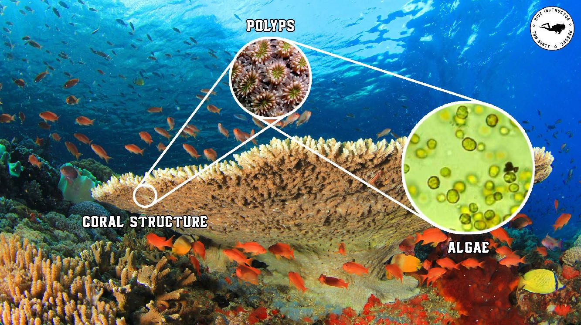
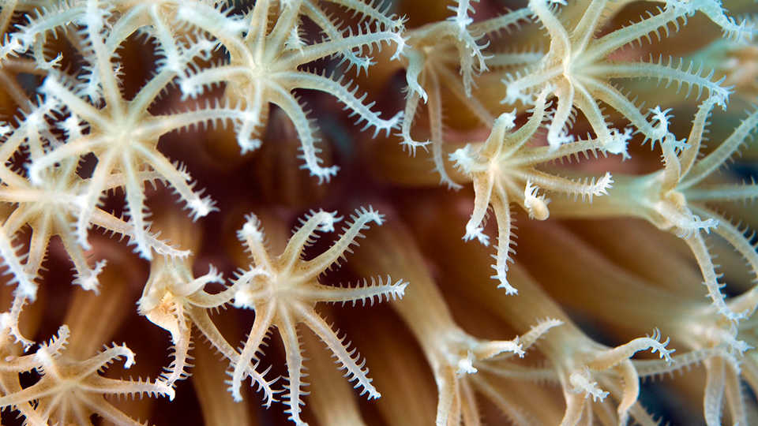
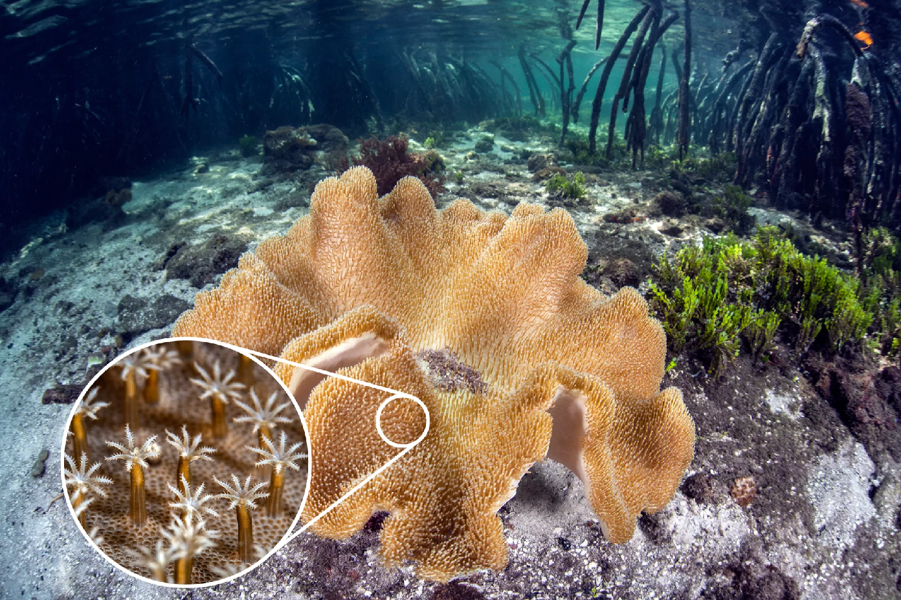
Coral reef
https://scubadiverlife.com/coral-biology-part/

Slide 6
Videos
1. https://www.youtube.com/watch?v=wbNeIn3vVKM (will replace with accessible video links later)
National Geographic, Great Barrier Reef | Exploring Oceans
2. Coral bleaching leaves Great Barrier Reef under threat.mp4
3. How dead is the Great Barrier Reef.mp4
4. How Scientists Are Restoring The Great Barrier Reef_Travel + Leisure.mp4

Slide 7
Food production impact - land use

Slide 8
Deforestation
The four maps show the changing vegetation in New Zealand since 700.
Cutting down large numbers of trees is called deforestation

Slide 9
Deforestation
Slash-and-burn farming in Brazil
Covering 31% of the planet's landmass, forests are the biggest absorber of carbon on Earth.
In the past 25 years, forests shrank by 502,000 square miles (1.3 million square km) — an area bigger than the size of South Africa. In 2018, The Guardian reported that every 2 seconds, a chunk of forest equivalent to the size of a soccer field is lost.

Slide 10
Videos
1. CNN Explains Deforestation.mp4
2. Satellite shows extent of terrible destruction to the planet - BBC.mp4
3. Deforestation Effects on Climate.mp4

Slide 11
Deforestation - effects on the ecosystem
1 Soil erosion
2 Flooding, mudslide
3 Loss of habitat for forest organisms
4 Loss of biodiversity (especially rainforest)
5 Affect carbon cycle (CO2 increase)
and water cycle (less transpiration, less water vapour in air, less rainfall)
6 climate change: global warming, less rainfall
Vocab: log, timber
Discussion: How does deforestation affect human’s life?
Describe how human activities increase soil erosion. (farming, deforestation & overgrazing)
http://scienceovereverything.com/2018/11/15/deforestation/
Notes:
Erosion caused by deforestation can initiate increased flood rates. Land which is converted into a pasture or crop field from forests or another natural landscape is less able to absorb water, which makes floods more common.
Biodiversity is a term used to describe the enormous variety of life on Earth.
Forests can be found from the tropics to high-latitude areas. They are home to 80% of terrestrial biodiversity.
Deforestation not only removes vegetation that is important for removing carbon dioxide from the air, but the act of clearing the forests also produces greenhouse gas emissions. The Food and Agriculture Organization of the United Nations says that deforestation is the second-leading cause of climate change. (The first is the burning of fossil fuels.) In fact, deforestation accounts for nearly 20% of greenhouse gas emissions.
Urban expansion at the expense of forested areas will also feel the heat. Trees retain a lot of water, keeping the air around forested areas cool. When those trees are replaced with the metal and concrete of buildings and highways, cities become heat islands and can get dangerously hot in the summer. Additionally, hotter air is able to dissolve more smog and particulate matter, making air quality dangerous for the elderly and people with asthma. As cities continue to grow and climate change makes summers hotter around the world, the problem will most likely get worse.

Slide 12
Global effects of deforestation
Silt, not slit

Slide 13
Conserve forests
Notes:
Does this mean we are doomed to a future without forests and the living things that thrive there? Or can humans give back to nature at least part of what we’ve taken?
Our fate might not yet be sealed. Reforestation initiatives across the world have taken on the task of restoring previously deforested land. Plant a Billion Trees, which is part of the Nature Conservancy, has ongoing reforestation projects in Brazil, China, and the US, and have already planted nearly 100 million trees. Eden Reforestation Projects have planted over 200,000 trees in Nepal, Madagascar, Haiti, Indonesia, and Ethiopia. And Conservation International is leading a project to restore 70,000 acres of the Amazon to its former glory, putting thousands of people to work in the process. You can even offset your individual carbon footprint by purchasing offsets from CarbonFund.org, where your donation is used to rebuild lost habitats.
But nature is complex and simply planting more trees will not immediately fix the problem. While a lot of lands has been reforested, biodiversity in these places are still lagging.
However, while a tree may able to be harvested after around 20 years, forests take around 100 years to reach full maturity. Protected and reforested areas have to stay that way for decades before their full benefits and biodiversity are realized. Only a long-term commitment, one that will take multiple generations and stable environmental policy, will allow for forests to reach their healthiest. Scientists are also concerned about the rate of deforestation. Even with habitat restoration efforts, researchers estimate that there may be no rainforest left within 100 years. Deforestation, combined with climate change, could spell the end for a wide range of species.
Efforts are being made to fight against deforestation at both the national level in several countries and at the global level. Brazil, for example, rolled out ambitious and enforceable legislation in 2004 to preserve the Amazon forest. Brazil and Indonesia, which together had the highest net loss of forest cover in the 1990s, have significantly reduced the rate of shrinkage.
At the international level, the United Nations has launched Reducing Emissions from Deforestation and Forest Degradation (REDD) and REDD+.
One reforested hectare does not equal one deforested hectare, as in most cases the reforested area does not have the same quality as a natural forest in terms of variety of species and protection of biodiversity.
The idea behind the REDD programs is to financially reward countries and communities that manage to reduce deforestation. The funding can come from institutions such as the World Bank or from non-governmental organizations (NGOs) that can act at the local level to remunerate cooperating villages. The fight against deforestation in Brazil's Amazon forest has been financed with bilateral aid from Norway. Specific mechanisms also allow corporations to finance forest projects and obtain credits that can be traded on carbon markets.

Slide 14
Conserve forests
The biodiversity of tropical rain forests is unparalleled. They retain some of the most diverse species on the planet. Many primitive and undiscovered species only exist in the rainforest.
How to conserve/ preserve forests?
A) Regulated and Planned Cutting of Trees: legal quotas, government limit granting licenses to logging companies, pass acts for the conservation of forests
B) Selective felling instead of clear-felling/ clear cutting (cut down all trees in a forest); Young and immature trees should not be felled, only fully mature trees will be allowed to be cut down.
Notes:
http://www.environmentalpollution.in/forest-conservation/how-to-conserve-forest-resources-8-steps/156
Slash and burn farming, overgrazing by cattle, shifting agriculture are all farming practices that are harmful to the environment and particularly to forests. We must keep all these practices under control.
Shifting cultivation is an agricultural system in which plot of land are cultivated temporarily, then abandoned while post-disturbance fallow vegetation is allowed to freely grow while the cultivator moves on to another plot.
Shelter wood cutting- This method entails that the least useful trees are cut down first, while the highest quality trees are cut down last.

Slide 15
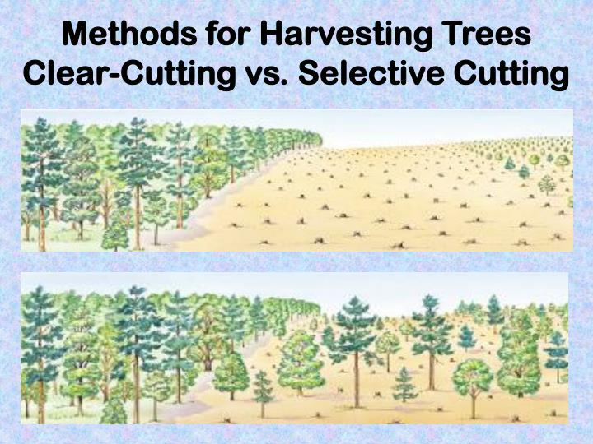
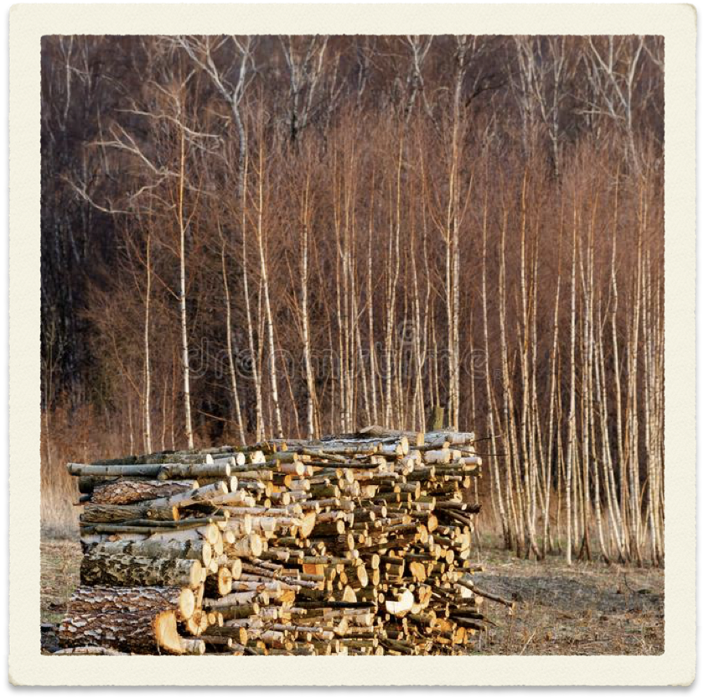
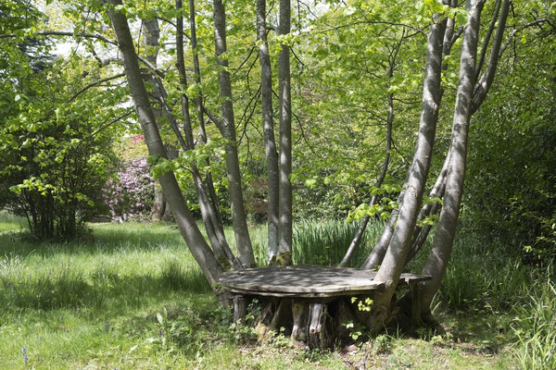
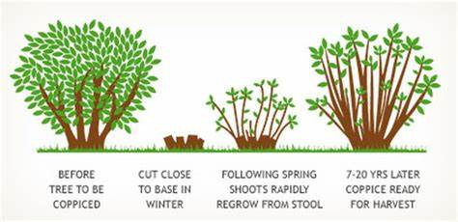
Logs
Coppicing

Slide 16
Conserve forests
C) Coppicing: leave stump to regrow, and then harvest
D) Education
E) Restocking - reforestation
Other actions like:
Avoid paper products or buy recycled paper products.
Use the hand dryer in the bathroom instead of paper towels.
Eat less meat.
Reduce the amount of petroleum you use, ride your bike instead of driving.
Educate others about what’s happening to build awareness.
Control over forest fire.
Print less, on double-sided paper, digital files.
Raise awareness through tourism

Slide 17
Videos
1. How To Save Our Forests and Rewild Our Planet.mp4
How to save forests: farm trees, etc.
2. This country isn't just carbon neutral — it's carbon negative Tshering Tobgay.mp4
Bhudan, carbon neutral country (Prime Minister Tshering Tobgay)

Slide 18
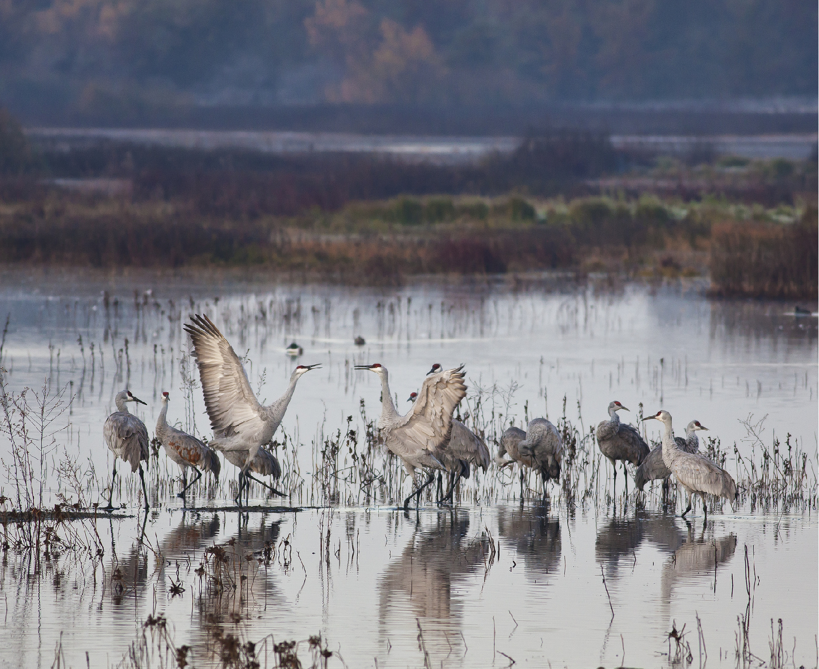

Wetland destruction

Slide 19
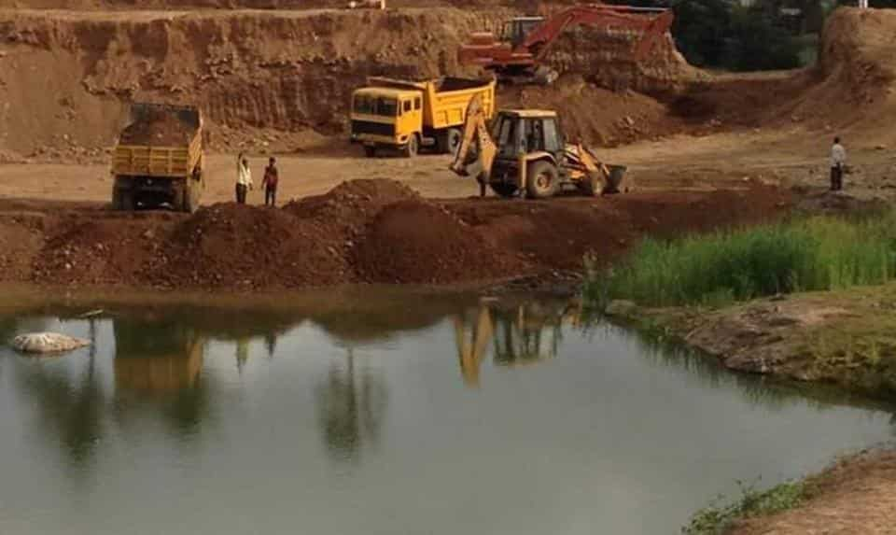
Wetland destruction
A wetland is a distinct ecosystem that is flooded by water, either permanently or seasonally.
The primary factor that distinguishes wetlands from other land forms or water bodies is the characteristic vegetation of aquatic plants, adapted to the unique hydric soil.
Notes:
Hydric soil is soil which is permanently or seasonally saturated by water, resulting in anaerobic conditions, as found in wetlands.

Slide 20
Wetland matters
They are some of the most productive habitats on the planet.
They often support high concentrations of animals—including mammals, birds, fish and invertebrates—and serve as nurseries for many of these species.
Wetlands also support the cultivation of rice, a staple in the diet of half the world’s population.
And they provide a range of ecosystem services that benefit humanity, including water filtration, water storage, storm protection, flood control and recreation.
Without wetlands, cities have to spend more money to treat water for their citizens, floods are more devastating to nearby communities, storm surges from hurricanes can penetrate farther inland, animals are displaced or die out, and food supplies are disrupted, along with livelihoods.
Destruction of wetlands is a systemic problem that calls for cooperative planning among communities, nonprofit organizations, governments, and industry.

